Slide 1
Deep Neural Networks

Slide 2



REVIEW: Perceptron
A linear model
$$a=w_{1}x_{1}+w_{2}x_{2}+…+w_{p}x_{p}+b$$
Decision based on $a$:
$$\begin{matrix}y=-1, & a<0 \\ y=+1, & a≥0\end{matrix}$$
bias
-1
Weights
Attributes
…
+1
Threshold-
Classification
Notes:
perceptron; multi-layer to make nn; figure out how to adjust parameters

Slide 3
Review: Multi-layer PERCEPTRON
$$×$$
$$∑$$
$$w_{1}$$
$$×$$
$$×$$
$$∑$$
$$h$$
$$x_{1}$$
$$w_{2}$$
$$×$$
$$×$$
$$x_{2}$$
$$∑$$
$$×$$

Slide 4

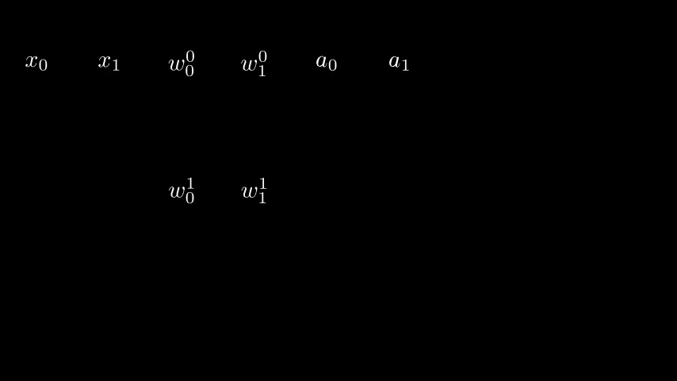
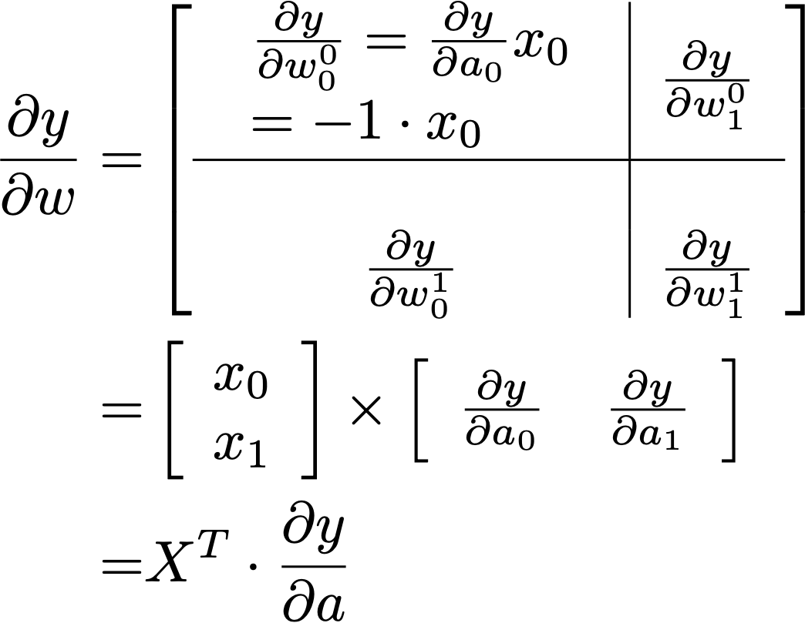
BP - 2a: A>>W
$$w_{0}^{0}$$
$$w_{1}^{0}$$
$$h_{0}$$
$$h_{1}$$
$$u_{0}^{0}$$
$$y_{0}$$
$$x_{0}$$
$$x_{1}$$
$$a_{0}$$
$$a_{1}$$
$$b_{0}$$
$$w_{0}^{1}$$
$$w_{1}^{1}$$
$$u_{0}^{1}$$
$$\begin{matrix} & \frac{∂y}{∂a}=[-1,0.5]\end{matrix}$$

Slide 5
MOD1: Essential elements making deep nets work

Slide 6
more layers
$$×$$
$$∑$$
$$w_{1}$$
$$×$$
$$×$$
$$∑$$
$$h$$
$$x_{1}$$
$$w_{2}$$
$$×$$
$$×$$
$$x_{2}$$
$$∑$$
$$×$$

Slide 7
Intuitive expansion
The most intuitive extension is simply adding more layers.

Slide 8
The cost Intuitive expansion
The simple scheme does not work well practically.
…

Slide 9
YOUR OPINION of the challenge
Q: Identify one essential challenge makes building Deep Nets a NON-trivial task given that one can build neural networks?
The degrees of freedom in a DNN are too many. It requires very large training data sets to ensure the training and the test performance of a model to be close.
The computational complexity of such a model is too high for them to apply in practice.
The degrees of freedom are many and the hypothesis space is very high dimensional. The relationship between the input and output of a network is nonlinear due to multiple steps of activation. Searching in such a high dimensional space is difficult.
Implementation of deep neural networks is very complicated and bug-prone.

Slide 10
Essentials to enable deep structure
Network Structure
Convolutional nets
ResNet (shortcut links)
Optimisation
Optimiser
Progress management schemes
Regularisation
Dropout
(Weight Decay etc.)

Slide 11


Structures
Save Degrees of Freedom / Regularisation
Convolutional Neural Networks
Computation
Linear Op: conv. is linear

Slide 12
Structures
Convolutional Neural Networks
Linear Op: conv. is linear

Slide 13
Structures
Convolutional Neural Networks
Linear Op: conv. is linear
Q: How many elements in the matrix?
20, X has 20 elements
120, X has 20 elements, Y has 6, totally we will need 20 * 6
6, there are 6 outputs in Y.
Q: How many elements in the matrix if we have the dim of I/O matrices (both rows and columns) *100?
120 * 100 = 12,000
$$120×{100}^{2}=1,200,000$$
$$120×{100}^{4}=12,000,000,000$$

Slide 14
Structures
Convolutional Neural Networks
Linear Op: conv. is linear
Q: How many DEGREES of FREEDOM in the conv. matrix?
120, as it has 120 elements
20, as all columns are the same, and each column has 20 elements
9, same as the elements in the 3*3 conv. kernel.

Slide 15
Structures
Save Degrees of Freedom / Regularisation
Residual Networks
Structure
Facilitates Backprop
+
+

Slide 16
optimisation
efficient and effective searching in $H$
A complicated landscape
High-order Information, Hessian Matrix
Ad hoc solutions: Momentum-based method

Slide 17
optimisation
efficient and effective searching in $H$
Q: When you have computed the most effective direction to change the parameters in a neural network, i.e. gradient $∇_{w}L$ for $W$ using back propagation, you can
We can let parameters $W$ update according to the gradient in one step and reduce the loss: $W←∇_{W}L+W$
$∇_{W}L$ is only a direction. We need to specify a step size. Generally, we update with a large step size to reduce the loss sufficiently: $W←Γ∇_{W}L+W$
$∇_{W}L$ is a direction. We need to specify a step size. But if we update with a large step size to reduce the TRAINING loss sufficiently, we may have bad generalisation on test data. So we update slowly: $W←γ∇_{W}L+W$
$∇_{W}L$ is only a LOCAL direction. If we update with a large step size, we may end up with NOT reducing the loss $L$ at all. So we update slowly: $W←γ∇_{W}L+W$

Slide 18
optimisation
efficient and effective searching in $H$
Dealing with large data
SGD and minibatch
Batch normalisation

Slide 19
Regularisation
Save Degrees of Freedom / Regularisation
Dropout
During TRAINING, randomly set a number of neurons to 0.
Weight Decay
… now to process h in this layer and feed to the next …
drop_mask = rand(h.shape) # sample shape
h[drop_mask<0.3] = 0 # set 30% elements to 0
… after computing loss, before backprop …
loss += norm(w) * lam
# by a factor lam, penalise big w

Slide 20
MOD2: Automatic Differential Architecture builder

Slide 21
Computational Graph
Computation as a Graph
Manage the elements in the graph and their relationships
D
Op
D
D

Slide 22
MOD3: deep networks example

Slide 23
Practical Project
Minibatch Training
for epoch in range(max_epoches): # loop over the dataset multiple times
for i, (inputs, labels) in enumerate(data_loader):
# zero the parameter gradients
optimiser.zero_grad()
# forward, assess output, backward, then adjust model param’s
outputs = net(inputs)
loss = fn.cross_entropy(outputs, labels)
loss.backward()
optimiser.step()
# [optional] print statistics, perform evaluation and maintain log

